Slide 2
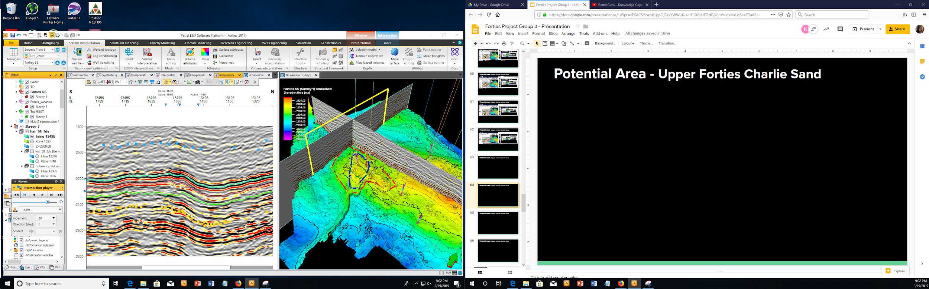
Potential Area - Upper Forties Charlie Sand

Slide 3
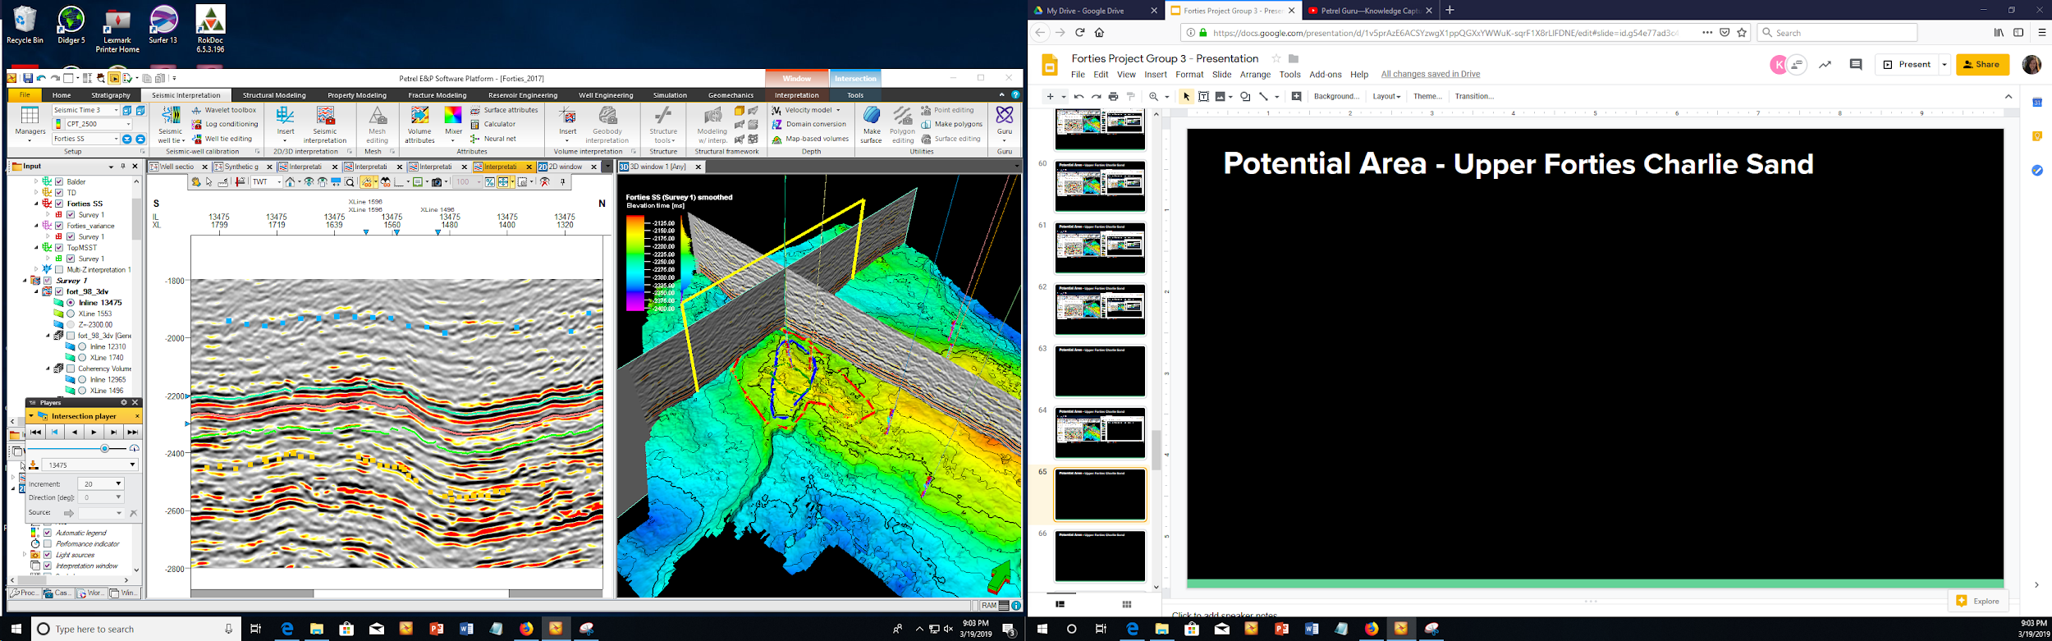
Potential Area - Upper Forties Charlie Sand

Slide 4
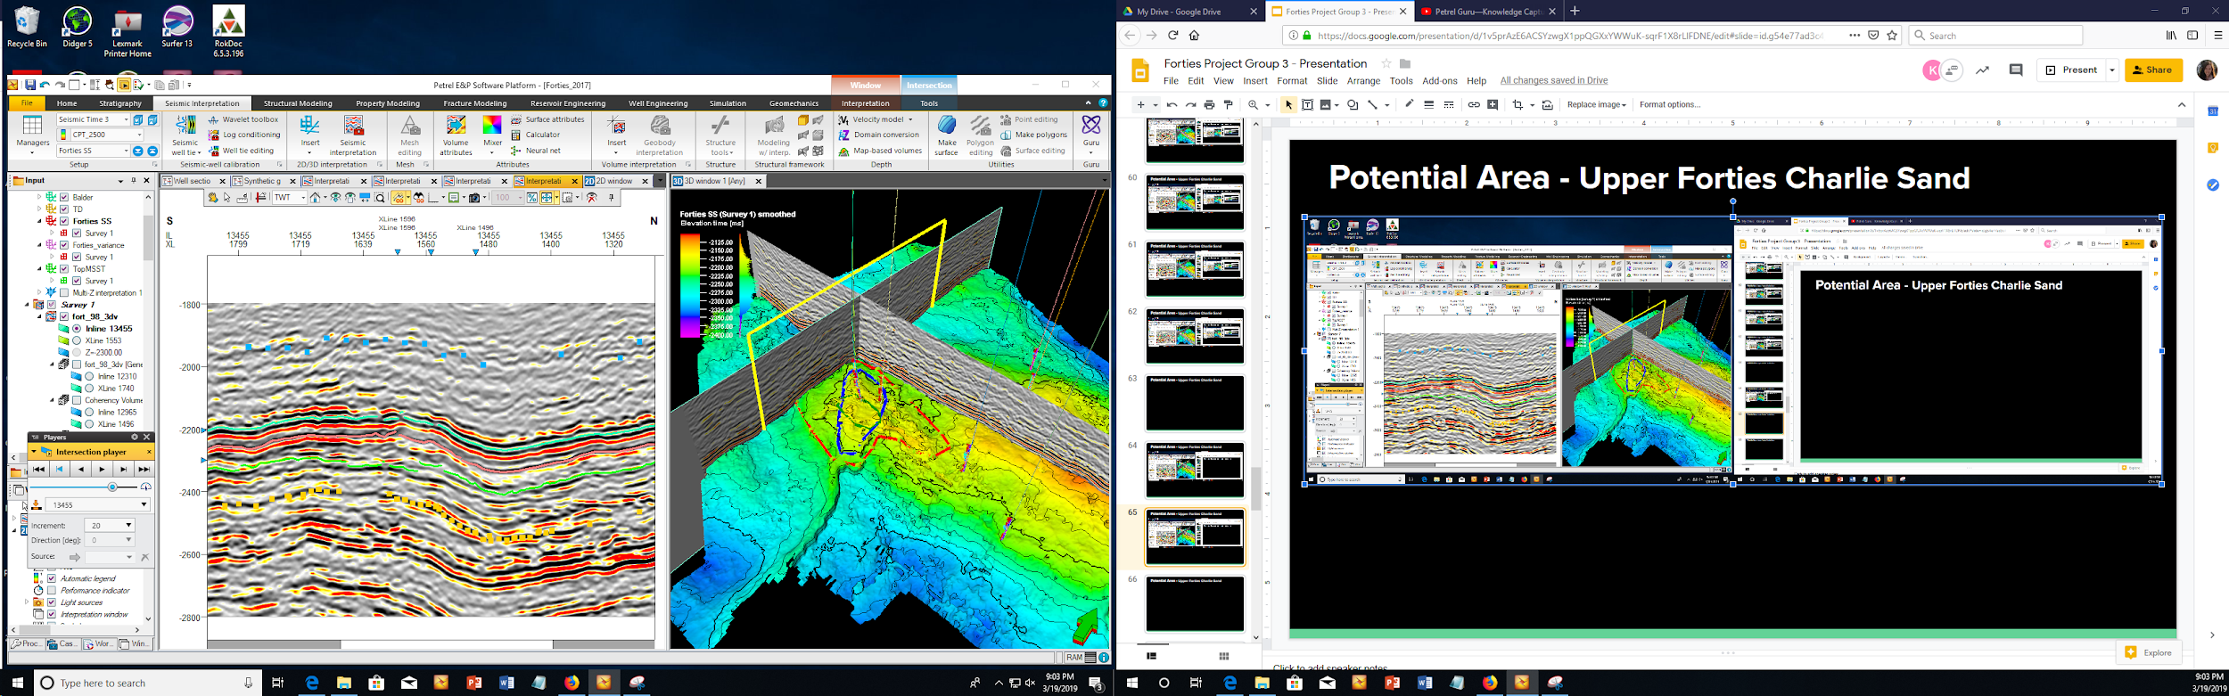
Potential Area - Upper Forties Charlie Sand

Slide 5
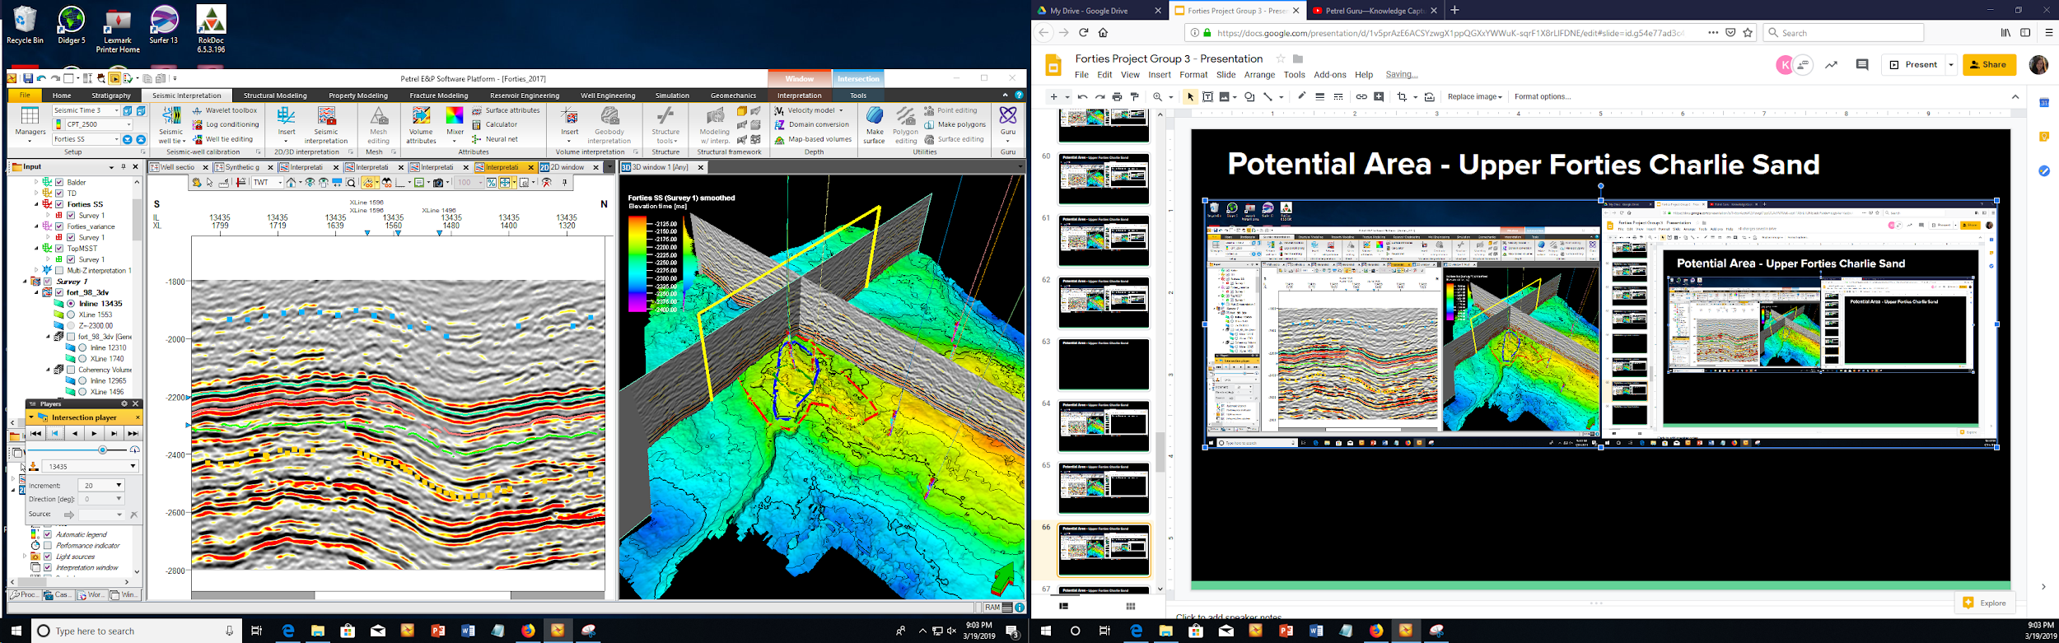
Potential Area - Upper Forties Charlie Sand

Slide 6

Potential Area - Upper Forties Charlie Sand

Slide 7

Potential Area - Upper Forties Charlie Sand

Slide 8
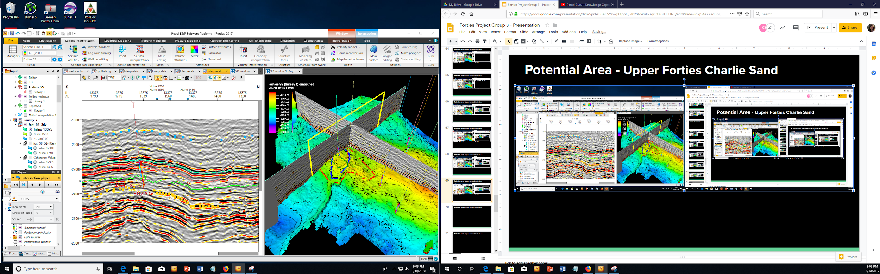
Potential Area - Upper Forties Charlie Sand

Slide 9

Potential Area - Upper Forties Charlie Sand

Slide 10

Potential Area - Upper Forties Charlie Sand

Slide 11
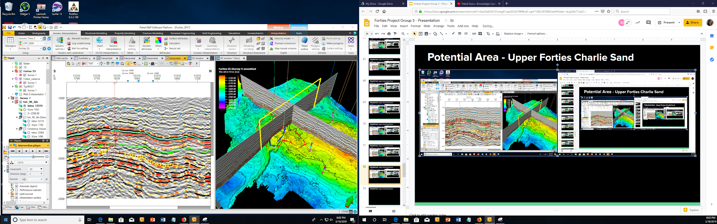
Potential Area - Upper Forties Charlie Sand

Slide 12
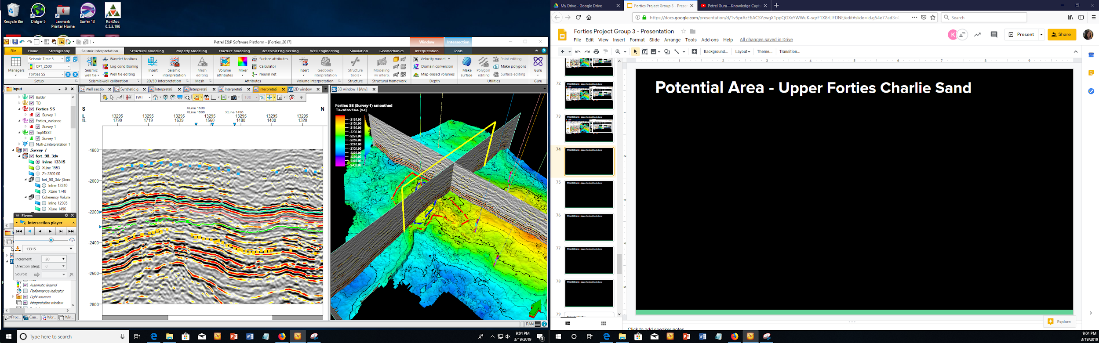
Potential Area - Upper Forties Charlie Sand

Slide 13
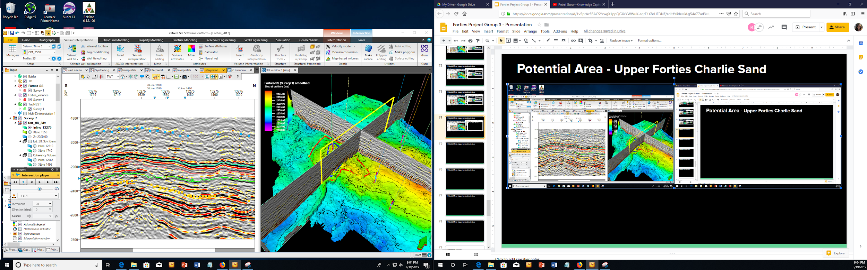
Potential Area - Upper Forties Charlie Sand

Slide 14

Potential Area - Upper Forties Charlie Sand

Slide 15
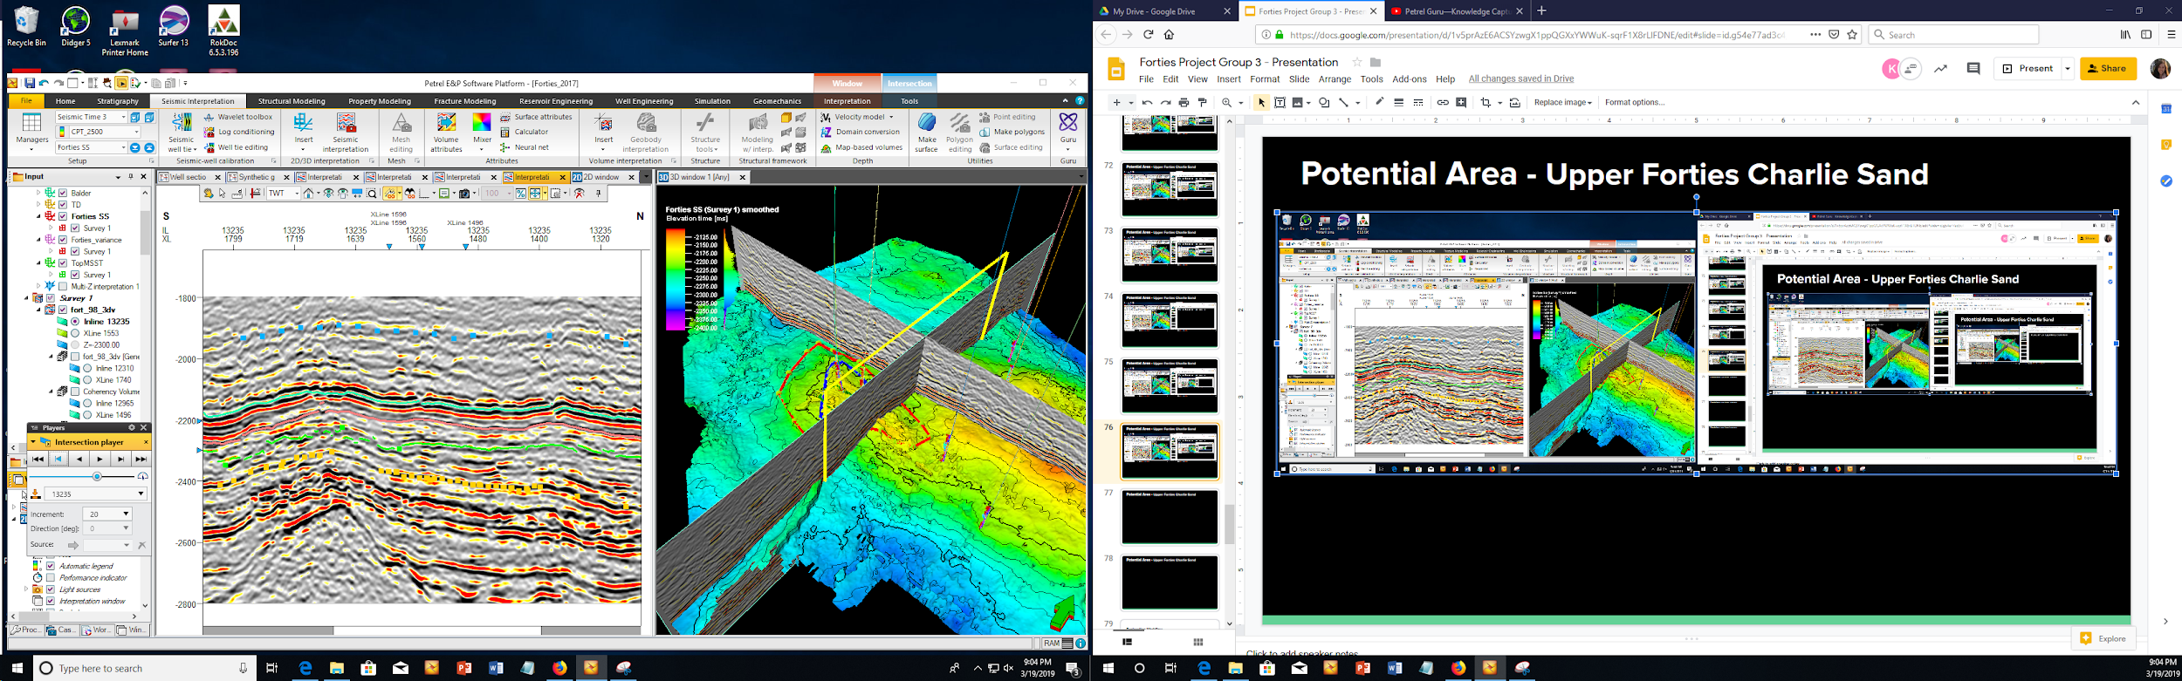
Potential Area - Upper Forties Charlie Sand

Slide 16
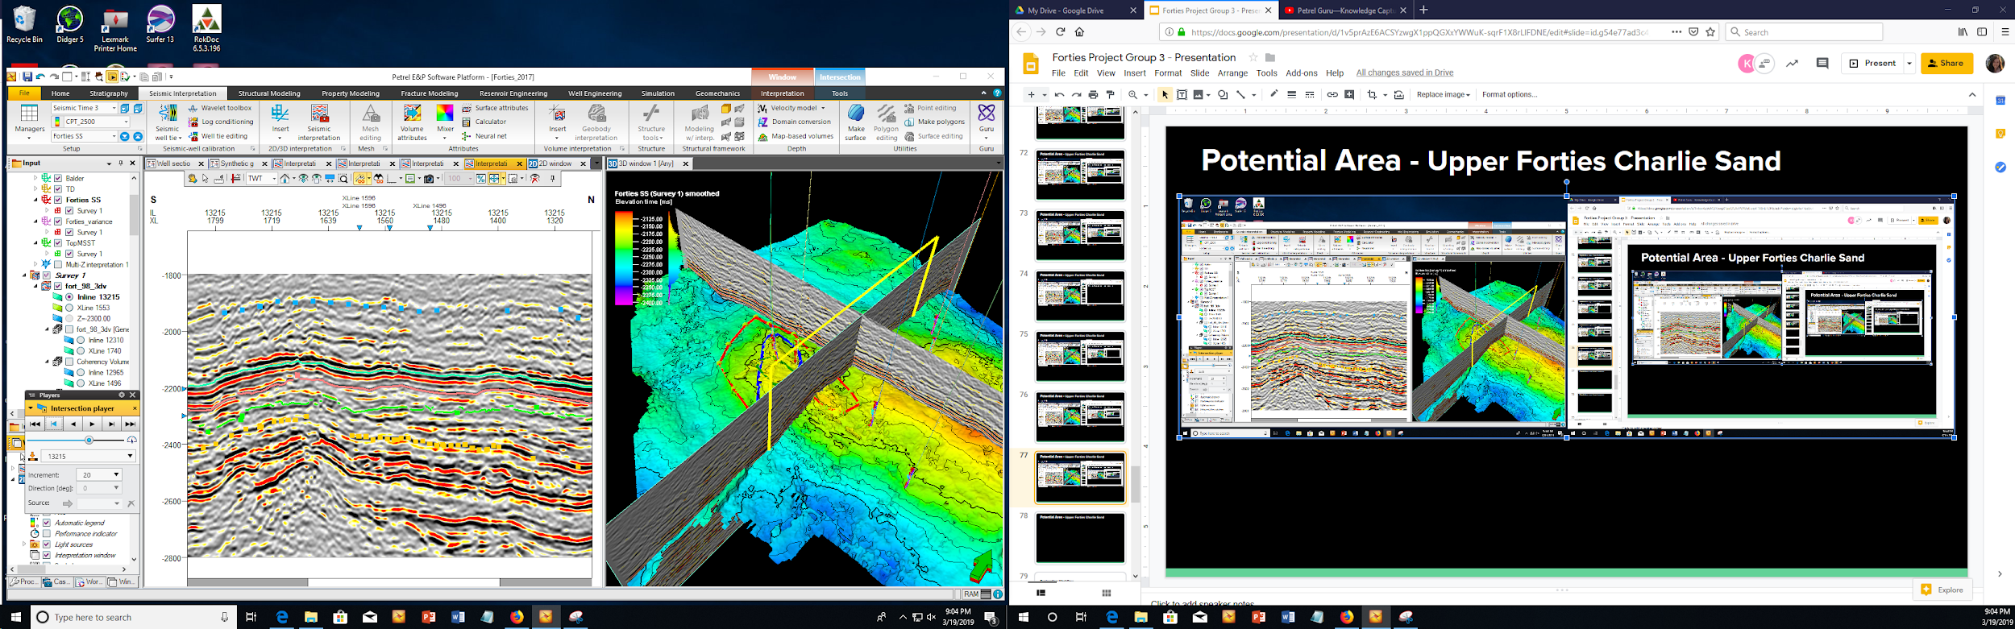
Potential Area - Upper Forties Charlie Sand

Slide 17
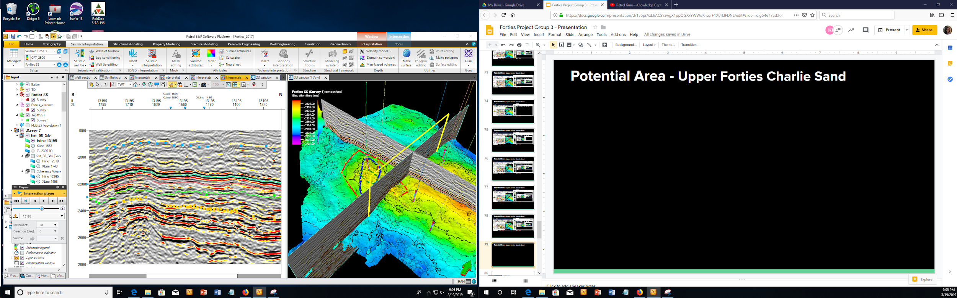
Potential Area - Upper Forties Charlie Sand

Slide 18

Potential Area - Upper Forties Charlie Sand

